Slide 1


Slide 2
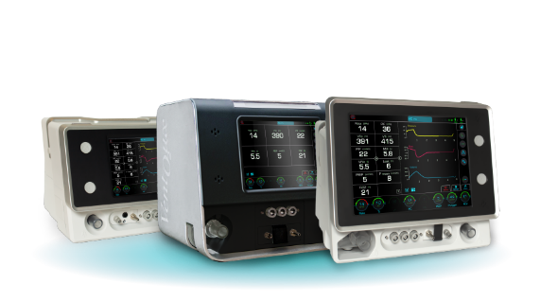

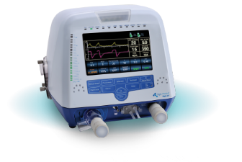
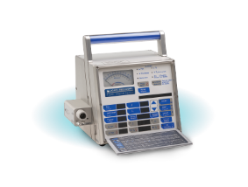

A HISTORY OF INNOVATIVE DESIGN
series
Flight F60 T
HT-50
Future
Launch in 2022
Present
2005-Today
Past
1996-2005

Slide 3

25,000
ventilators
50+
countries

Slide 4


Fully Compliant

Slide 5


In-house
Design and manufacturing
Meeting the needs of patients and clinicians

Slide 6
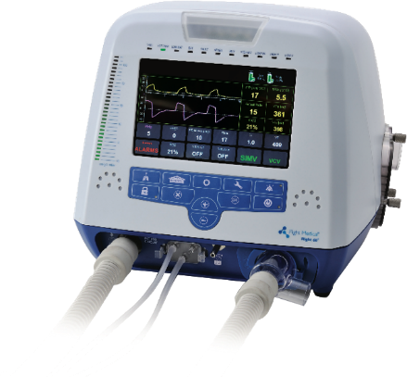

Flight F60 T
ICU-level ventilator for efficient NIV
in long/short-term acute care facilities
Reliable Ventilation for every patient across the spectrum of care
ICU quality ventilation in 5.5 Kg vent

Slide 7






Flight F60 T
ICU-level ventilator for efficient NIV
in long/short-term acute care facilities
Intensive care
Intra & inter-hospital transport
Emergency preparedness
Air & ground transport
Homecare

Slide 8



Flight F60 T
High Flow Oxygen Therapy (HFOT)
Non-invasive respiratory support
to improve oxygenation while easing
the work of breathing

Slide 9
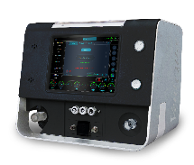
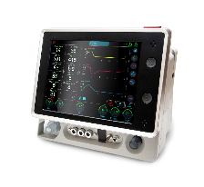
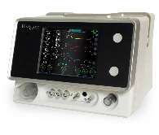
Series
vt1
The next generation
by Flight Medical
vc3
vc2

Slide 10


Series
ICU-level ventilation
for every care setting

Slide 11


Series
High performance,cost-effective ventilator series

Slide 12

Series
Unique cuff
pressure controller
Designed to prevent ventilator associated pneumonia (VAP) and reduce clinical intervention
The only compact, portable ventilator with this innovative add-on module

Slide 13



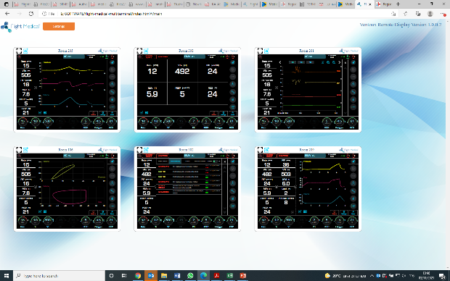
Series
Remote Display
Monitor remotely, from anywhere

Slide 14

vt1
Rigid Ventilator
EMS & Transport

Slide 15
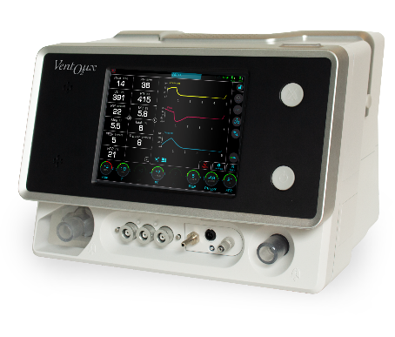
vc2
Homecare, long-term care,
EMS & intra-hospital transport

Slide 16

vc3
Large display
for ER & critical care

Slide 17
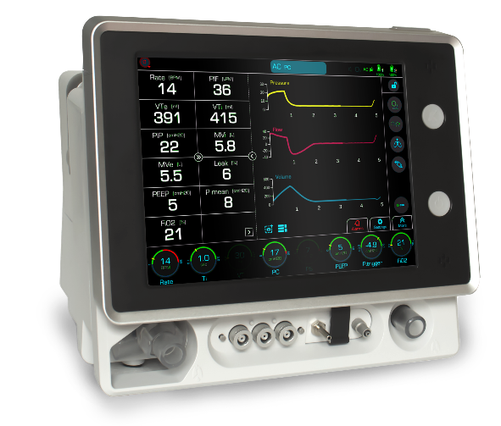
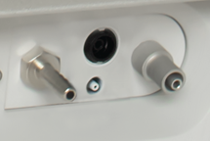
Customized Solutions
Advanced
mode ventilation
Advanced alarm system
Intuitive interface
Capnography module
Integrated automatic cuff pressure controller
Integrated nebulizer

Slide 18
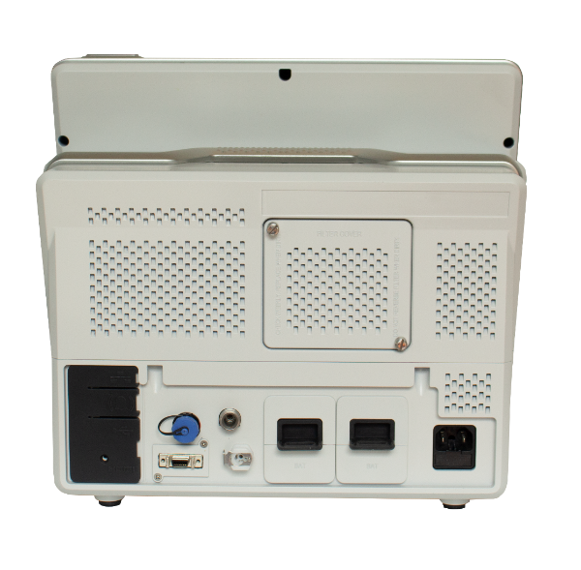
Customized Solutions
Hot swappable batteries with up to
6 hrs. operation time
High O₂ pressure port
Integrated SpO₂ module
Low-flow O₂

